Slide 1
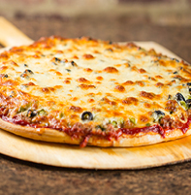
Wai Lam Wong Marcelo Troiani Steve Liao Angelo Garetto
Project - Beggars

Slide 2

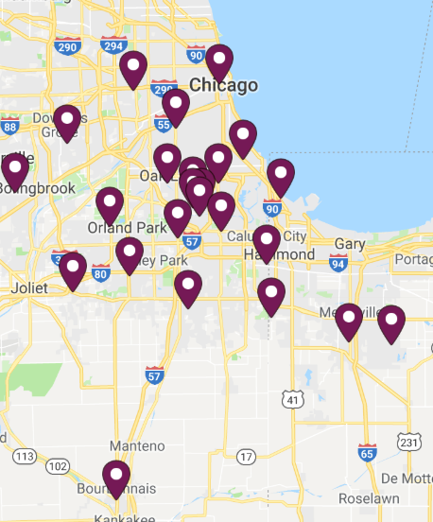
-Family operated company with 25 units -Run in a traditional fashion How to use Data to understand our customers… -How does Yelp impact store performance? -Do coupons create new customers? -What are millennial’s ordering tendencies?
Motivation

Slide 3

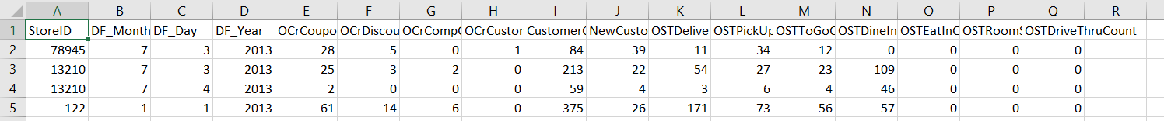
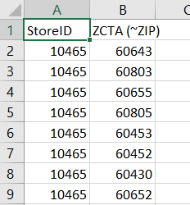
- Point of Sale MySQL Database - ACS Census - Google API - Yelp API
Data Sources

Slide 4
Analysis on Jupyter

Slide 5
What if we had more time?
-Examine seasonality of coupon usage, order type mix -Examine coupon effect on day -Create A/B tests by store group based on some census data to see what type of coupon drives business and creates new customers
-Evaluate what parts of individual delivery zones are saturated or underserviced
-Drill down census data in “Mickey” stores to find commonalities to predict successful delivery areas
-Examine our online ordering order counts by store and compare it grubhub growth
-Look at past decisions and see detailed results of that decision(we transitioned all area deliveries to 1 location, did we lose customers in the process?)
-Look at historical sales data and labor data to predict future sales and estimate required labor force

Slide 6
Questions?

